Slide 1


Basic Details of the Team and Problem Statement
Ministry/Organization Name/Student Innovation: AICTE, MIC-Student Innovation
PS Code: SIH1477
Problem Statement Title: Student Innovation
Team Name: Victorious
Team Leader Name: Priyanshu Kumar Saw
Institute Code (AISHE):U0747
Institute Name: Chandigarh University
Theme Name: Smart Vehicles

Slide 2

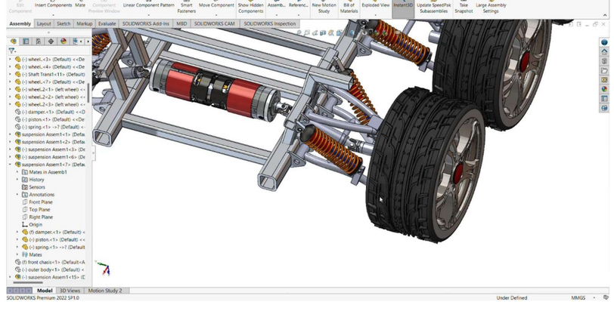
Idea/Approach Details
USP
(Unique selling point)
Our motive is to develop an electric powered autonomously driven amphibious vehicle for surveillance with 3D mapping, land mine detection, & obstacle avoidance capabilities. It will have cameras, LIDAR, ultrasonic sensors for surveillance, buoyancy for water operations, and a durable design.
Quieter
Modularity
Geo-mapping and terrain sensing
An electric Powered Autonomously driven
All-terrain
Amphibious Vehicle
which is able to perform tasks like
Surveillance
Object detection.
We are using our patented technology (Explosive Detection Device) to detect several types of landmines
Why?
Versatile Terrain Adaptability
Warfield Surveillance
Underground Tunnel Detection
Bomb detection
Water Floatable
Environment Friendly
2

Slide 3


Slide 4
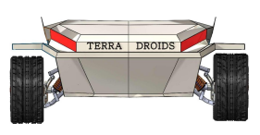
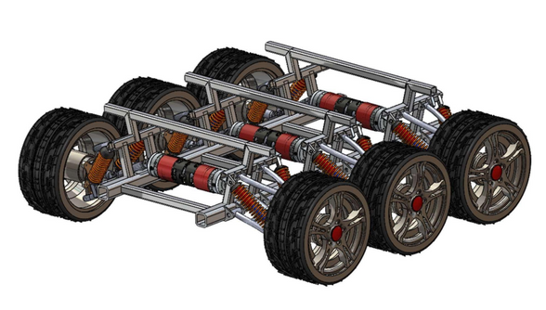
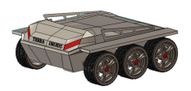
3 Types of bomb detection
Prototype:
Nitrate Tetra acid
Phosphorus acid
Tetranitrate phosphorous acid
FRONT VIEW
Budget
Estimated Budget :- 3,09,210
CHASSIS VIEW
Patent number
Explosive bomb detection:- 202311014046
ISOMETRIC VIEW
3

